Slide 1
CSP571 Data Preparation and Analysis
Lecture 15. Convolutional Neural Networks. Visualizing Deep Learning Networks
Oleksandr Narykov
onarykov@iit.edu

Slide 2
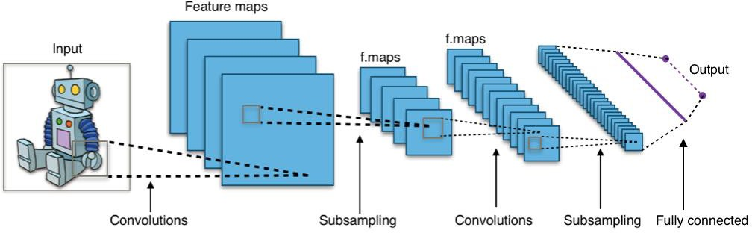
Convolutional Neural Networks
https://commons.wikimedia.org/wiki/File:Typical_cnn.png
19

Slide 3
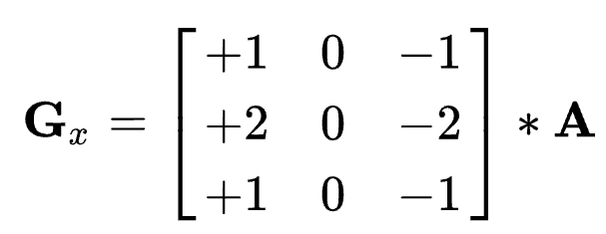
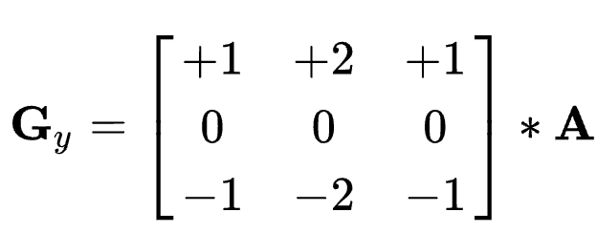
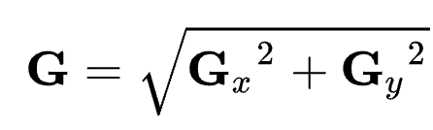
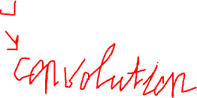
Feature Engineering
Using domain knowledge to transform data
Sobel operator in Computer Vision
5

Slide 4
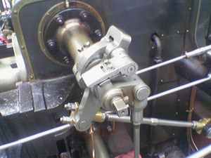
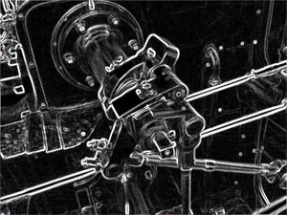
Feature Engineering
Using domain knowledge to transform data
Sobel operator in Computer Vision
5

Slide 5
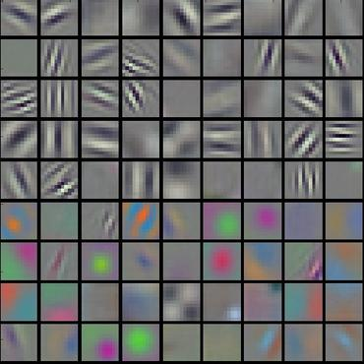
Convolution Network
End-to-end learning
Deep learning is representation learning
Weight matrices of hidden layers of convolution network

Slide 6
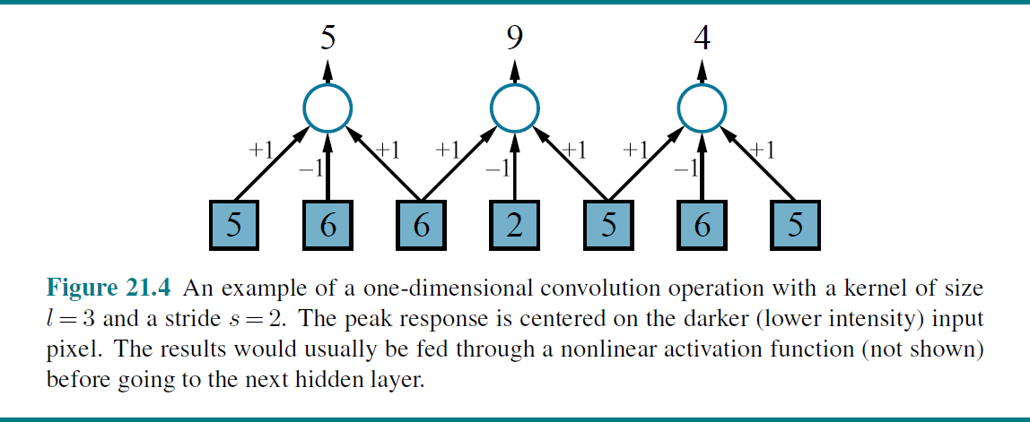
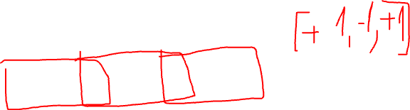
Convolution
Figure from http://aima.cs.berkeley.edu/figures.pdf
20

Slide 7
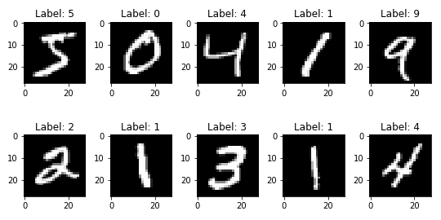
Convolution and Pattern Recognition
Let’s consider greyscale digits in MNIST
20

Slide 8
Convolution and Pattern Recognition
Let’s consider greyscale digits in MNIST
For example, digit 9
20

Slide 9
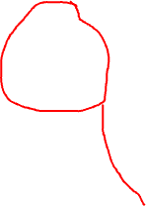
Convolution and Pattern Recognition
0 | 0 | 0 | 0 | 0 | 0 | 0 | 0
0 | 0 | 0 | 1 | 1 | 0 | 0 | 0
0 | 0 | 1 | 0 | 0 | 1 | 0 | 0
0 | 0 | 1 | 0 | 0 | 1 | 0 | 0
0 | 0 | 0 | 1 | 1 | 1 | 0 | 0
0 | 0 | 0 | 0 | 0 | 1 | 0 | 0
0 | 0 | 0 | 0 | 0 | 1 | 0 | 0
0 | 0 | 0 | 0 | 0 | 0 | 1 | 0
Let’s consider greyscale digits in MNIST
For example, digit 9
Let’s construct simple encoding
20

Slide 10
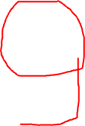
Convolution and Pattern Recognition
0 | 0 | 0 | 0 | 0 | 0 | 0 | 0
0 | 0 | 0 | 1 | 1 | 0 | 0 | 0
0 | 0 | 1 | 0 | 0 | 1 | 0 | 0
0 | 0 | 1 | 0 | 0 | 1 | 0 | 0
0 | 0 | 0 | 1 | 1 | 1 | 0 | 0
0 | 0 | 0 | 0 | 0 | 1 | 0 | 0
0 | 0 | 0 | 0 | 0 | 1 | 0 | 0
0 | 0 | 0 | 0 | 0 | 0 | 1 | 0
0 | 1 | 1 | 0
1 | 0 | 0 | 1
1 | 0 | 0 | 1
0 | 1 | 1 | 1
0 | 0 | 0 | 1
0 | 1 | 1 | 1
Image
Template
We can scan an image for a given template
20

Slide 11
Convolution and Pattern Recognition
0 | 0 | 0 | 0 | 0 | 0 | 0 | 0
0 | 0 | 0 | 1 | 1 | 0 | 0 | 0
0 | 0 | 1 | 0 | 0 | 1 | 0 | 0
0 | 0 | 1 | 0 | 0 | 1 | 0 | 0
0 | 0 | 0 | 1 | 1 | 1 | 0 | 0
0 | 0 | 0 | 0 | 0 | 1 | 0 | 0
0 | 0 | 0 | 0 | 0 | 1 | 0 | 0
0 | 0 | 0 | 0 | 0 | 0 | 1 | 0
0 | 1 | 1 | 0
1 | 0 | 0 | 1
1 | 0 | 0 | 1
0 | 1 | 1 | 1
0 | 0 | 0 | 1
0 | 1 | 1 | 1
Image
Template
We can scan an image for a given template
What are the possible locations of our given template in an image?
20

Slide 12
Convolution and Pattern Recognition
0 | 0 | 0 | 0 | 0 | 0 | 0 | 0
0 | 0 | 0 | 1 | 1 | 0 | 0 | 0
0 | 0 | 1 | 0 | 0 | 1 | 0 | 0
0 | 0 | 1 | 0 | 0 | 1 | 0 | 0
0 | 0 | 0 | 1 | 1 | 1 | 0 | 0
0 | 0 | 0 | 0 | 0 | 1 | 0 | 0
0 | 0 | 0 | 0 | 0 | 1 | 0 | 0
0 | 0 | 0 | 0 | 0 | 0 | 1 | 0
0 | 1 | 1 | 0
1 | 0 | 0 | 1
1 | 0 | 0 | 1
0 | 1 | 1 | 1
0 | 0 | 0 | 1
0 | 1 | 1 | 1
Image
Template
We can scan an image for a given template
What are the possible locations of our given template in an image?
20

Slide 13
Convolution and Pattern Recognition
0 | 0 | 0 | 0 | 0 | 0 | 0 | 0
0 | 0 | 0 | 1 | 1 | 0 | 0 | 0
0 | 0 | 1 | 0 | 0 | 1 | 0 | 0
0 | 0 | 1 | 0 | 0 | 1 | 0 | 0
0 | 0 | 0 | 1 | 1 | 1 | 0 | 0
0 | 0 | 0 | 0 | 0 | 1 | 0 | 0
0 | 0 | 0 | 0 | 0 | 1 | 0 | 0
0 | 0 | 0 | 0 | 0 | 0 | 1 | 0
0 | 1 | 1 | 0
1 | 0 | 0 | 1
1 | 0 | 0 | 1
0 | 1 | 1 | 1
0 | 0 | 0 | 1
0 | 1 | 1 | 1
Image
Template
We can scan an image for a given template
What are the possible locations of our given template in an image?
20

Slide 14
Convolution and Pattern Recognition
0 | 0 | 0 | 0 | 0 | 0 | 0 | 0
0 | 0 | 0 | 1 | 1 | 0 | 0 | 0
0 | 0 | 1 | 0 | 0 | 1 | 0 | 0
0 | 0 | 1 | 0 | 0 | 1 | 0 | 0
0 | 0 | 0 | 1 | 1 | 1 | 0 | 0
0 | 0 | 0 | 0 | 0 | 1 | 0 | 0
0 | 0 | 0 | 0 | 0 | 1 | 0 | 0
0 | 0 | 0 | 0 | 0 | 0 | 1 | 0
0 | 1 | 1 | 0
1 | 0 | 0 | 1
1 | 0 | 0 | 1
0 | 1 | 1 | 1
0 | 0 | 0 | 1
0 | 1 | 1 | 1
Image
Template
We can scan an image for a given template
What are the possible locations of our given template in an image?
20

Slide 15
Convolution and Pattern Recognition
0 | 0 | 0 | 0 | 0 | 0 | 0 | 0
0 | 0 | 0 | 1 | 1 | 0 | 0 | 0
0 | 0 | 1 | 0 | 0 | 1 | 0 | 0
0 | 0 | 1 | 0 | 0 | 1 | 0 | 0
0 | 0 | 0 | 1 | 1 | 1 | 0 | 0
0 | 0 | 0 | 0 | 0 | 1 | 0 | 0
0 | 0 | 0 | 0 | 0 | 1 | 0 | 0
0 | 0 | 0 | 0 | 0 | 0 | 1 | 0
0 | 1 | 1 | 0
1 | 0 | 0 | 1
1 | 0 | 0 | 1
0 | 1 | 1 | 1
0 | 0 | 0 | 1
0 | 1 | 1 | 1
Image
Template
We can scan an image for a given template
What are the possible locations of our given template in an image?
20

Slide 16
Convolution and Pattern Recognition
0 | 0 | 0 | 0 | 0 | 0 | 0 | 0
0 | 0 | 0 | 1 | 1 | 0 | 0 | 0
0 | 0 | 1 | 0 | 0 | 1 | 0 | 0
0 | 0 | 1 | 0 | 0 | 1 | 0 | 0
0 | 0 | 0 | 1 | 1 | 1 | 0 | 0
0 | 0 | 0 | 0 | 0 | 1 | 0 | 0
0 | 0 | 0 | 0 | 0 | 1 | 0 | 0
0 | 0 | 0 | 0 | 0 | 0 | 1 | 0
0 | 1 | 1 | 0
1 | 0 | 0 | 1
1 | 0 | 0 | 1
0 | 1 | 1 | 1
0 | 0 | 0 | 1
0 | 1 | 1 | 1
Image
Template
We can scan an image for a given template
What are the possible locations of our given template in an image?
20

Slide 17
Convolution and Pattern Recognition
0 | 0 | 0 | 0 | 0 | 0 | 0 | 0
0 | 0 | 0 | 1 | 1 | 0 | 0 | 0
0 | 0 | 1 | 0 | 0 | 1 | 0 | 0
0 | 0 | 1 | 0 | 0 | 1 | 0 | 0
0 | 0 | 0 | 1 | 1 | 1 | 0 | 0
0 | 0 | 0 | 0 | 0 | 1 | 0 | 0
0 | 0 | 0 | 0 | 0 | 1 | 0 | 0
0 | 0 | 0 | 0 | 0 | 0 | 1 | 0
0 | 1 | 1 | 0
1 | 0 | 0 | 1
1 | 0 | 0 | 1
0 | 1 | 1 | 1
0 | 0 | 0 | 1
0 | 1 | 1 | 1
Image
Template
We are using a sliding window to scan an image for the potential locations
20

Slide 18
Convolution and Pattern Recognition
0 | 0 | 0 | 0 | 0 | 0 | 0 | 0
0 | 0 | 0 | 1 | 1 | 0 | 0 | 0
0 | 0 | 1 | 0 | 0 | 1 | 0 | 0
0 | 0 | 1 | 0 | 0 | 1 | 0 | 0
0 | 0 | 0 | 1 | 1 | 1 | 0 | 0
0 | 0 | 0 | 0 | 0 | 1 | 0 | 0
0 | 0 | 0 | 0 | 0 | 1 | 0 | 0
0 | 0 | 0 | 0 | 0 | 0 | 1 | 0
0 | 1 | 1 | 0
1 | 0 | 0 | 1
1 | 0 | 0 | 1
0 | 1 | 1 | 1
0 | 0 | 0 | 1
0 | 1 | 1 | 1
Image
Template
We are using a sliding window to scan an image for the potential locations
We are moving our window by one pixel at a time. So, our stride
equals to 1
20

Slide 19
Convolution and Pattern Recognition
0 | 0 | 0 | 0 | 0 | 0 | 0 | 0
0 | 0 | 0 | 1 | 1 | 0 | 0 | 0
0 | 0 | 1 | 0 | 0 | 1 | 0 | 0
0 | 0 | 1 | 0 | 0 | 1 | 0 | 0
0 | 0 | 0 | 1 | 1 | 1 | 0 | 0
0 | 0 | 0 | 0 | 0 | 1 | 0 | 0
0 | 0 | 0 | 0 | 0 | 1 | 0 | 0
0 | 0 | 0 | 0 | 0 | 0 | 1 | 0
0 | 1 | 1 | 0
1 | 0 | 0 | 1
1 | 0 | 0 | 1
0 | 1 | 1 | 1
0 | 0 | 0 | 1
0 | 1 | 1 | 1
Image
Template
We can increase stride to decrease the number of matches made
20

Slide 20
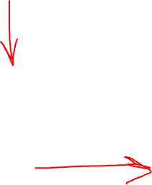
Convolution and Pattern Recognition
0 | 0 | 0 | 0 | 0 | 0 | 0 | 0
0 | 0 | 0 | 1 | 1 | 0 | 0 | 0
0 | 0 | 1 | 0 | 0 | 1 | 0 | 0
0 | 0 | 1 | 0 | 0 | 1 | 0 | 0
0 | 0 | 0 | 1 | 1 | 1 | 0 | 0
0 | 0 | 0 | 0 | 0 | 1 | 0 | 0
0 | 0 | 0 | 0 | 0 | 1 | 0 | 0
0 | 0 | 0 | 0 | 0 | 0 | 1 | 0
0 | 1 | 1 | 0
1 | 0 | 0 | 1
1 | 0 | 0 | 1
0 | 1 | 1 | 1
0 | 0 | 0 | 1
0 | 1 | 1 | 1
?
Scores 3x5
Template 6x4
Image 8x8
We cover each potential location with our pattern
How do we calculate similarity?
20

Slide 21

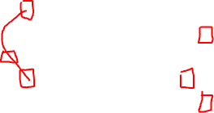
Convolution and Pattern Recognition
0 | 0 | 0 | 0 | 0 | 0 | 0 | 0
0 | 0 | 0 | 1 | 1 | 0 | 0 | 0
0 | 0 | 1 | 0 | 0 | 1 | 0 | 0
0 | 0 | 1 | 0 | 0 | 1 | 0 | 0
0 | 0 | 0 | 1 | 1 | 1 | 0 | 0
0 | 0 | 0 | 0 | 0 | 1 | 0 | 0
0 | 0 | 0 | 0 | 0 | 1 | 0 | 0
0 | 0 | 0 | 0 | 0 | 0 | 1 | 0
0 | 1 | 1 | 0
1 | 0 | 0 | 1
1 | 0 | 0 | 1
0 | 1 | 1 | 1
0 | 0 | 0 | 1
0 | 1 | 1 | 1
3
$$×$$
Scores 3x5
Template 6x4
Image 8x8
Let’s consider dot product
20

Slide 22
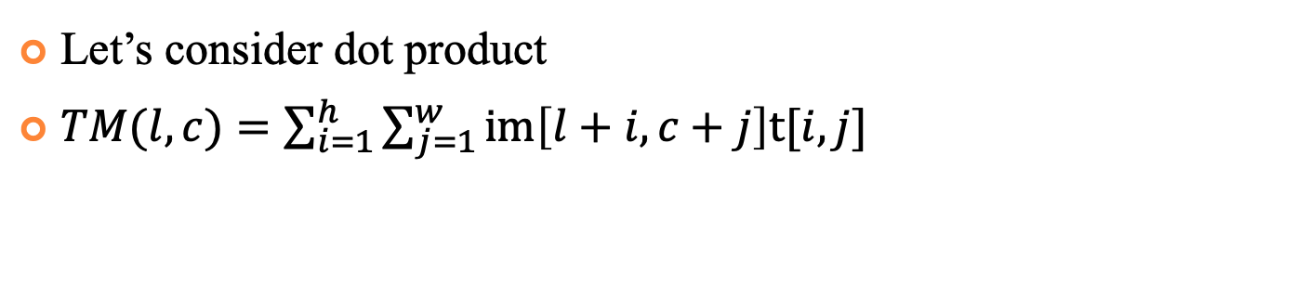
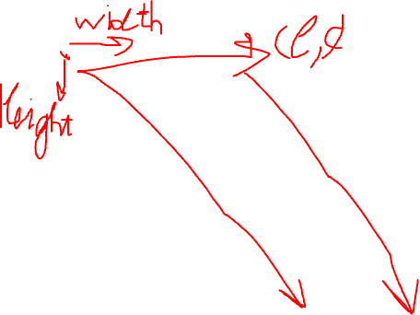
Convolution and Pattern Recognition
0 | 0 | 0 | 0 | 0 | 0 | 0 | 0
0 | 0 | 0 | 1 | 1 | 0 | 0 | 0
0 | 0 | 1 | 0 | 0 | 1 | 0 | 0
0 | 0 | 1 | 0 | 0 | 1 | 0 | 0
0 | 0 | 0 | 1 | 1 | 1 | 0 | 0
0 | 0 | 0 | 0 | 0 | 1 | 0 | 0
0 | 0 | 0 | 0 | 0 | 1 | 0 | 0
0 | 0 | 0 | 0 | 0 | 0 | 1 | 0
0 | 1 | 1 | 0
1 | 0 | 0 | 1
1 | 0 | 0 | 1
0 | 1 | 1 | 1
0 | 0 | 0 | 1
0 | 1 | 1 | 1
3
 |  | 11
$$×$$
Scores 3x5
Template 6x4
Image 8x8
Let’s consider dot product
$TM(l, c)=\sum_{i=1}^{h}{\sum_{j=1}^{w}{im\left[l+i,c+j\right]t[i,j]}}$
20

Slide 23
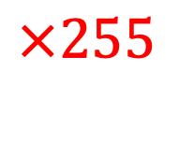
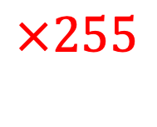
Convolution and Pattern Recognition
$$×255$$
0 | 0 | 0 | 0 | 0 | 0 | 0 | 0
0 | 0 | 0 | 1 | 1 | 0 | 0 | 0
0 | 0 | 1 | 0 | 0 | 1 | 0 | 0
0 | 0 | 1 | 0 | 0 | 1 | 0 | 0
0 | 0 | 0 | 1 | 1 | 1 | 0 | 0
0 | 0 | 0 | 0 | 0 | 1 | 0 | 0
0 | 0 | 0 | 0 | 0 | 1 | 0 | 0
0 | 0 | 0 | 0 | 0 | 0 | 1 | 0
0 | 1 | 1 | 0
1 | 0 | 0 | 1
1 | 0 | 0 | 1
0 | 1 | 1 | 1
0 | 0 | 0 | 1
0 | 1 | 1 | 1
$$×255$$
3
 |  | 11
$$×$$
Scores 3x5
Template 6x4
Image 8x8
Let’s add intensity to the image
Scores for the bright instances would be inflated
We need to normalize
20

Slide 24
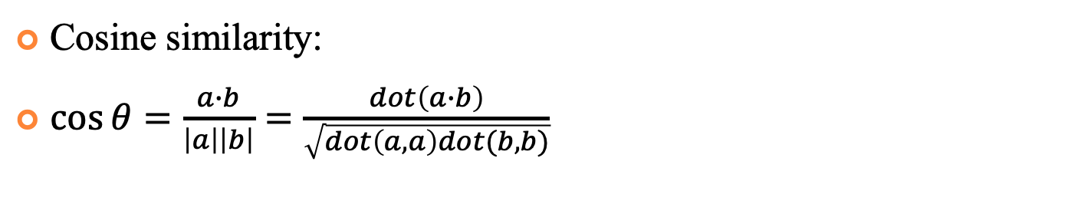
Cosine Similarity
$$×255$$
0 | 0 | 0 | 0 | 0 | 0 | 0 | 0
0 | 0 | 0 | 1 | 1 | 0 | 0 | 0
0 | 0 | 1 | 0 | 0 | 1 | 0 | 0
0 | 0 | 1 | 0 | 0 | 1 | 0 | 0
0 | 0 | 0 | 1 | 1 | 1 | 0 | 0
0 | 0 | 0 | 0 | 0 | 1 | 0 | 0
0 | 0 | 0 | 0 | 0 | 1 | 0 | 0
0 | 0 | 0 | 0 | 0 | 0 | 1 | 0
0 | 1 | 1 | 0
1 | 0 | 0 | 1
1 | 0 | 0 | 1
0 | 1 | 1 | 1
0 | 0 | 0 | 1
0 | 1 | 1 | 1
$$×255$$
3
 |  | 11
$$×$$
Scores 3x5
Template 6x4
Image 8x8
Cosine similarity:
$\cos{θ=\frac{a∙b}{\left|a\right|\left|b\right|}=\frac{dot\left(a∙b\right)}{\sqrt{dot\left(a,a\right)dot(b,b)}}}$
20

Slide 25
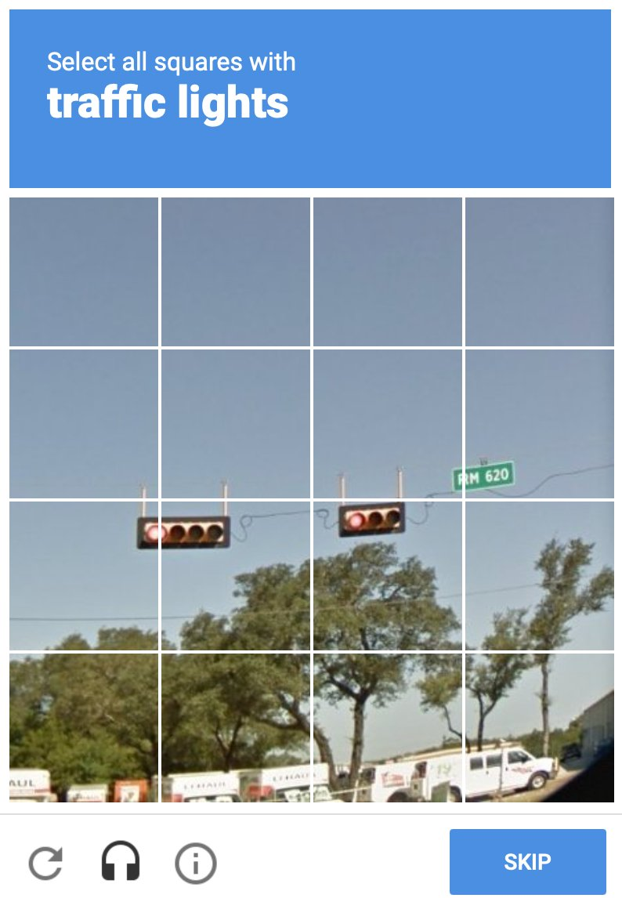
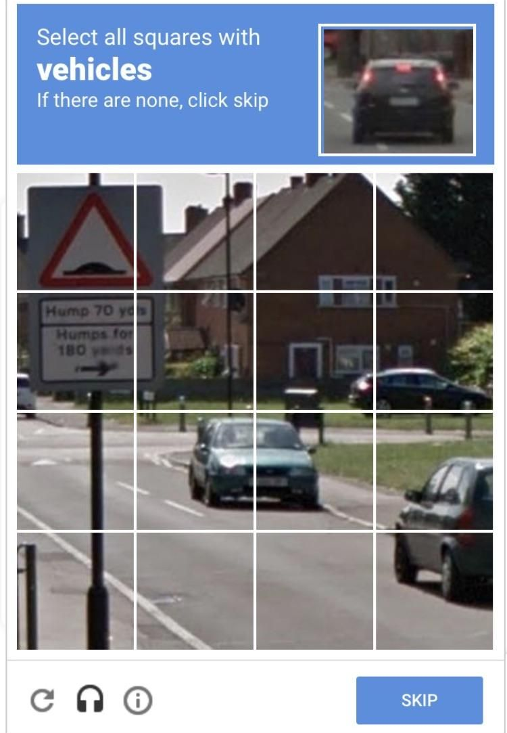
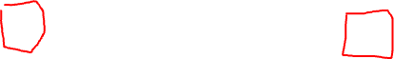
Padding
What if only part of the pattern is present on the image?
20

Slide 26
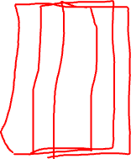
Padding
0 | 0 | 0 | 0 | 0 | 0 | 0 | 0 | 0 | 0
0 | 0 | 0 | 0 | 0 | 0 | 0 | 0 | 0 | 0
0 | 0 | 0 | 0 | 1 | 1 | 0 | 0 | 0 | 0
0 | 0 | 0 | 1 | 0 | 0 | 1 | 0 | 0 | 0
0 | 0 | 0 | 1 | 0 | 0 | 1 | 0 | 0 | 0
0 | 0 | 0 | 0 | 1 | 1 | 1 | 0 | 0 | 0
0 | 0 | 0 | 0 | 0 | 0 | 1 | 0 | 0 | 0
0 | 0 | 0 | 0 | 0 | 0 | 1 | 0 | 0 | 0
0 | 0 | 0 | 0 | 0 | 0 | 0 | 1 | 0 | 0
0 | 0 | 0 | 0 | 0 | 0 | 0 | 0 | 0 | 0
0 | 1 | 1 | 0
1 | 0 | 0 | 1
1 | 0 | 0 | 1
0 | 1 | 1 | 1
0 | 0 | 0 | 1
0 | 1 | 1 | 1
 | 3
 |  |  | 11
$$×$$
Scores 5x7
Template 6x4
Image 10x10
What if only part of the pattern is present on the image?
20

Slide 27
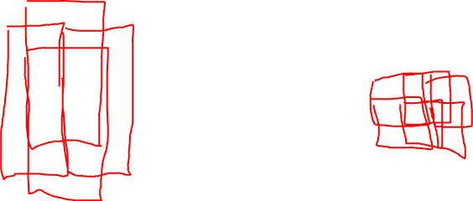
Pooling
3 | 11 | 11
 | 11 | 11
0 | 0 | 0 | 0 | 0 | 0 | 0 | 0
0 | 0 | 0 | 1 | 1 | 0 | 0 | 0
0 | 0 | 1 | 0 | 0 | 1 | 0 | 0
0 | 0 | 1 | 0 | 0 | 1 | 0 | 0
0 | 0 | 0 | 1 | 1 | 1 | 0 | 0
0 | 0 | 0 | 0 | 0 | 1 | 0 | 0
0 | 0 | 0 | 0 | 0 | 1 | 0 | 0
0 | 0 | 0 | 0 | 0 | 0 | 1 | 0
0 | 1 | 1 | 0
1 | 0 | 0 | 1
1 | 0 | 0 | 1
0 | 1 | 1 | 1
0 | 0 | 0 | 1
0 | 1 | 1 | 1
Max Pooling 2x4
3
 |  | 11
$$×$$
Scores 3x5
Template 6x4
Image 8x8
We do not expect our pattern to appear multiple times in overlaps
We are consolidating information about the region via pooling
20

Slide 28
Pooling
Aggregates a set of adjacent units
Like convolution, has a kernel size and a stride size
Unlike convolution, weights are fixed (not learned)
Examples
Average pooling
Max pooling
21

Slide 29
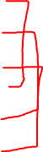
Convolution as a Linear Function
Convolution operation is a linear function and can be expressed as a matrix multiplication
Let’s consider 1-D example
1
2
-2
0
3
1
2
3
-1
-2
4
Image
Kernel
Feature Map
21

Slide 30
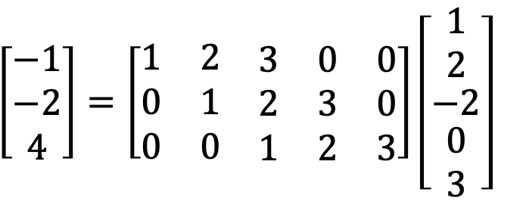
Convolution as a Linear Function
1
2
-2
0
3
1
2
3
-1
-2
4
Image
Kernel
Feature Map
$$\left[\begin{matrix}−1 \\ −2 \\ 4\end{matrix}\right]=\left[\begin{matrix}1 & 2 & \begin{matrix}3 & 0 & 0\end{matrix} \\ 0 & 1 & \begin{matrix}2 & 3 & 0\end{matrix} \\ 0 & 0 & \begin{matrix}1 & 2 & 3\end{matrix}\end{matrix}\right]\left[\begin{matrix}1 \\ 2 \\ \begin{matrix}−2 \\ \begin{matrix}0 \\ 3\end{matrix}\end{matrix}\end{matrix}\right]$$
h
W
21
x

Slide 31
Convolution as a Linear Function
W is a special representation of kernel, circulant matrix
The large number of elements in W is 0. The rest is repeated. There are only 3 actual free parameters
It provides a strong regularizing effect
$$\left[\begin{matrix}−1 \\ −2 \\ 4\end{matrix}\right]=\left[\begin{matrix}1 & 2 & \begin{matrix}3 & 0 & 0\end{matrix} \\ 0 & 1 & \begin{matrix}2 & 3 & 0\end{matrix} \\ 0 & 0 & \begin{matrix}1 & 2 & 3\end{matrix}\end{matrix}\right]\left[\begin{matrix}1 \\ 2 \\ \begin{matrix}−2 \\ \begin{matrix}0 \\ 3\end{matrix}\end{matrix}\end{matrix}\right]$$
h
W
21
x

Slide 32
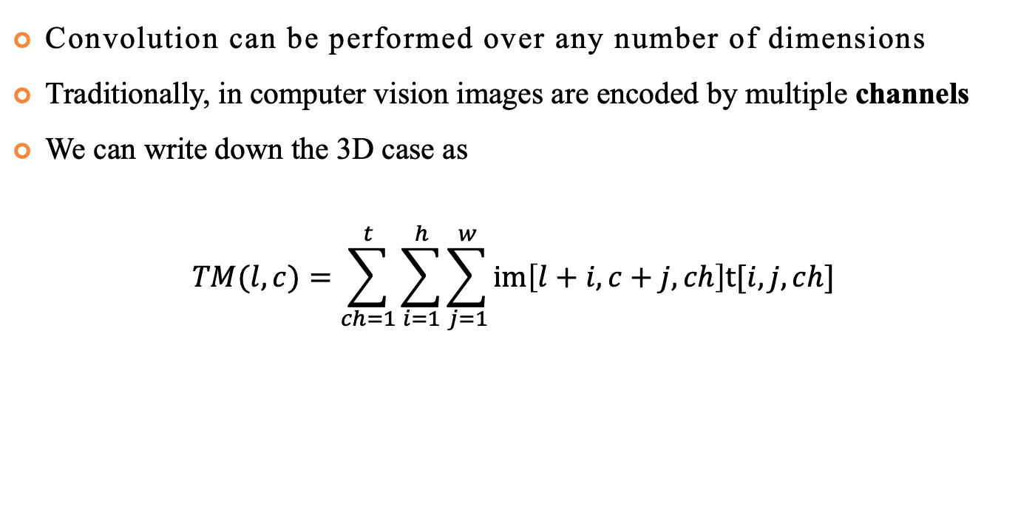

More Dimensions
Convolution can be performed over any number of dimensions
Traditionally, in computer vision images are encoded by multiple channels
We can write down the 3D case as
$$TM(l, c)=\sum_{ch=1}^{t}{\sum_{i=1}^{h}{\sum_{j=1}^{w}{im\left[l+i,c+j,ch\right]t[i,j,ch]}}}$$
21

Slide 33
3D Case
4 | 3 | 7 | 1
8 | 5 | 6 | 4
8 | 4 | 3 | 6
3 | 4 | 7 | 3
2 | 3 | 4 | 7
4 | 5 | 6 | 3
4 | 3 | 7 | 4
8 | 4 | 5 | 9
5 | 3 | 4 | 7
4 | 8 | 6 | 3
4 | 7 | 7 | 4
8 | 3 | 8 | 7
1 | -1
-1 | 1
1 | 0
0 | 1
R
5 | 0
0 | 3
G
B
Image
Kernels
21

Slide 34

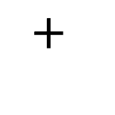
3D Case
4 | 3 | 7 | 1
8 | 5 | 6 | 4
8 | 4 | 3 | 6
3 | 4 | 7 | 3
$$×$$
1 | -1
-1 | 1
R
$$+$$
2 | 3 | 4 | 7
4 | 5 | 6 | 3
4 | 3 | 7 | 4
8 | 4 | 5 | 9
$$×$$
1 | 0
0 | 1
G
$$+$$
5 | 3 | 4 | 7
4 | 8 | 6 | 3
4 | 7 | 7 | 4
8 | 3 | 8 | 7
5 | 0
0 | 3
$$×$$
B
21
Image
Kernels

Slide 35
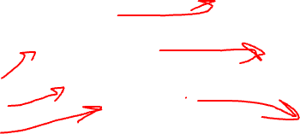
Multiple Kernels
4 | 3 | 7 | 1
8 | 5 | 6 | 4
8 | 4 | 3 | 6
3 | 4 | 7 | 3
1 | 0
2 | 1
1 | 3
-1 | 1
1 | -1
-1 | 1
Image
Kernels
Feature Maps
We can apply multiple kernels to the same image
It means not only we can take a multi-channel image as input, we can also produce multi-channel images as output
21

Slide 36
Multiple Kernels
1 | 0
2 | 1
1 | 3
-1 | 1
1 | -1
-1 | 1
4 | 3 | 7 | 1
8 | 5 | 6 | 4
8 | 4 | 3 | 6
3 | 4 | 7 | 3
4 | 3 | 7 | 1
8 | 5 | 6 | 4
8 | 4 | 3 | 6
3 | 4 | 7 | 3
1 | 0
2 | 1
1 | 3
-1 | 1
4 | 3 | 7 | 1
8 | 5 | 6 | 4
8 | 4 | 3 | 6
3 | 4 | 7 | 3
1 | -1
-1 | 1
1 | 0
2 | 1
1 | 3
-1 | 1
1 | -1
-1 | 1
Image
Kernels
Feature Maps
This complexity stacks up
21

Slide 37
Multiple Kernels
4 | 3 | 7 | 1
8 | 5 | 6 | 4
8 | 4 | 3 | 6
3 | 4 | 7 | 3
4 | 3 | 7 | 1
8 | 5 | 6 | 4
8 | 4 | 3 | 6
3 | 4 | 7 | 3
1 | 0
2 | 1
4 | 3 | 7 | 1
8 | 5 | 6 | 4
8 | 4 | 3 | 6
3 | 4 | 7 | 3
1 | 3
-1 | 1
1 | -1
-1 | 1
1 | 0
2 | 1
1 | 3
-1 | 1
1 | -1
-1 | 1
1 | 0
2 | 1
1 | 3
-1 | 1
1 | -1
-1 | 1
Image
Kernels
Feature Maps
This complexity stacks up
21

Slide 38
Convolutional Neural Networks
CNNs are a special case of Feed-Forward Neural Networks that consist of 1 or more convolutional layers
CNNs usually feature some non-convolutional layers, too
They revolutionized computer vision and made a significant impact on object detection, segmentation, object and activity recognition
21

Slide 39
Convolutional Neural Networks
In CNNs, kernels are automatically inferred from the input data
4 | 3 | 7 | 1
8 | 5 | 6 | 4
8 | 4 | 3 | 6
3 | 4 | 7 | 3
1 | -1
-1 | 1
$$×$$
21
Inputs
Weights
Hidden Layer

Slide 40
Convolutional Neural Networks
In CNNs, kernels are automatically inferred from the input data
Inputs may be non-sequential
4 | 3 | 7 | 1
8 | 5 | 6 | 4
8 | 4 | 3 | 6
3 | 4 | 7 | 3
1 | -1
-1 | 1
$$×$$
21
Inputs
Weights
Hidden Layer

Slide 41

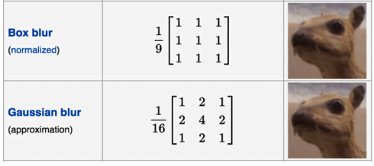
Examples of Kernels/Filters

Slide 42
Convolutional Neural Networks
Common CNNs features:
Multiple convolution layers
Pooling layers between some convolutional ones
Non-linear activation function between each layer
Fully-connected layers at the end
Trend since 2016:
Less pooling
More convolutional layers

Slide 43
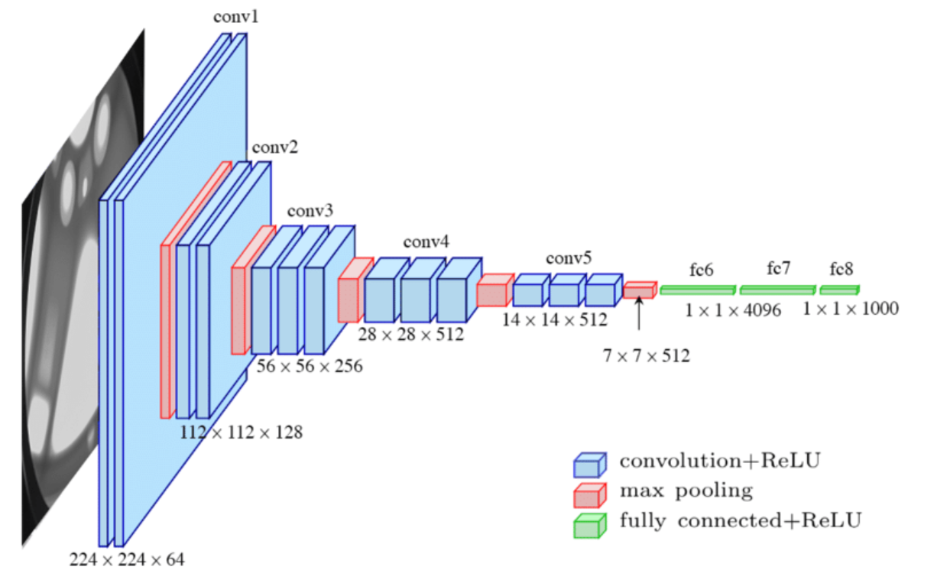
Convolutional Neural Networks
https://vitalflux.com/wp-content/uploads/2021/11/VGG16-CNN-Architecture.png

Slide 44
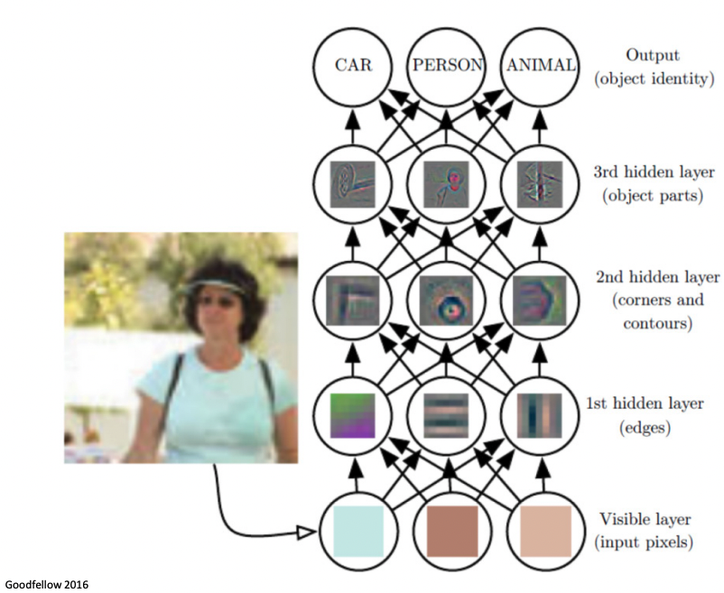
Convolutional Neural Networks

Slide 45
Visualization Aspects of Deep Learning
Debugging model training
Model optimization
Interpretability and explainability
Notes:
Model optimization: Models with fewer parameters are generally faster to compute and more resource-efficient while being more robust and generalizing better to unseen samples. Visualizations can uncover which parts of a model are essential – and which layers might be omitted without compromising the model’s performance.
Interpretability and explainability: The performance of deep learning models is, at times, staggering, even for seasoned data scientists and ML engineers. Visualizations provide ways to dive into a model’s structure and uncover why it succeeds in learning the relationships encoded in the training data.
Debugging model training: It’s fair to assume that everyone training deep learning models has encountered a situation where a model doesn’t learn or struggles with a particular set of samples. The reasons for this range from wrongly connected model components to misconfigured optimizers. Visualizations are great for monitoring training runs and diagnosing issues.

Slide 46
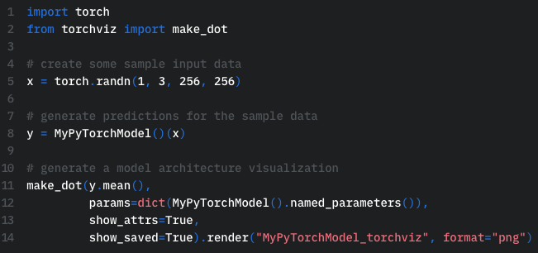
Visualizing Architecture
TorchViz

Slide 47
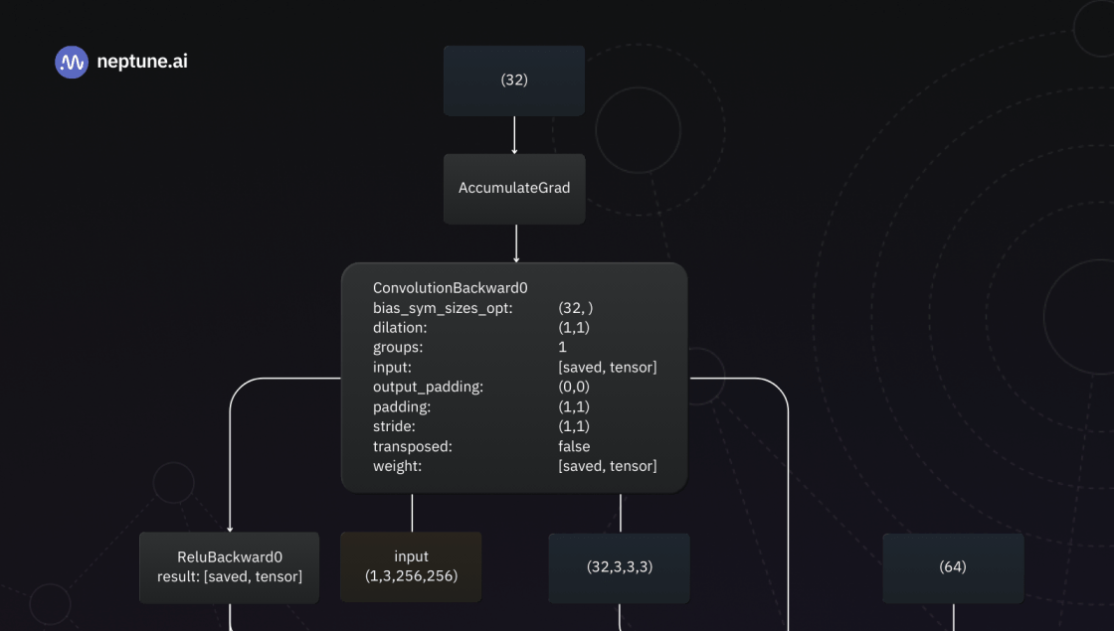
Visualizing Architecture
https://i0.wp.com/neptune.ai/wp-content/uploads/2024/08/deep-learning-visualization.png?resize=1020%2C1530&ssl=1

Slide 48
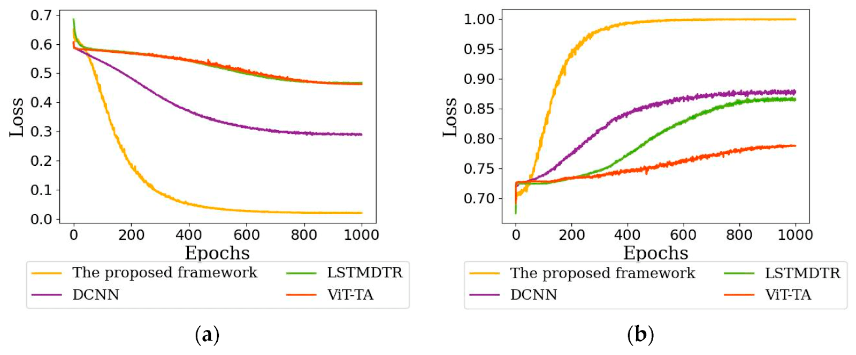
Training Dynamics
Learning progression
Early stopping
https://www.mdpi.com/2361466
Notes:
Learning Progression: Training dynamics plots reveal how quickly or slowly a model converges. Rapid convergence can point to overfitting, while erratic fluctuations may indicate issues like poor initialization or improper learning rate tuning.
Early Stopping: Plotting losses helps to identify the point at which a model starts overfitting the training data. A decreasing training loss while the validation loss rises is a clear sign of overfitting. The point where overfitting sets in is the optimal time to halt training.

Slide 49
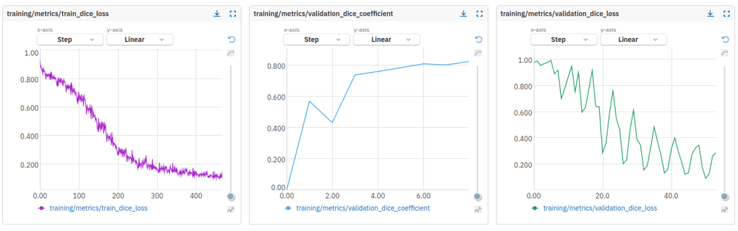
Training Dynamics
Learning progression
Early stopping
https://www.mdpi.com/2361466
Notes:
Learning Progression: Training dynamics plots reveal how quickly or slowly a model converges. Rapid convergence can point to overfitting, while erratic fluctuations may indicate issues like poor initialization or improper learning rate tuning.
Early Stopping: Plotting losses helps to identify the point at which a model starts overfitting the training data. A decreasing training loss while the validation loss rises is a clear sign of overfitting. The point where overfitting sets in is the optimal time to halt training.

Slide 50
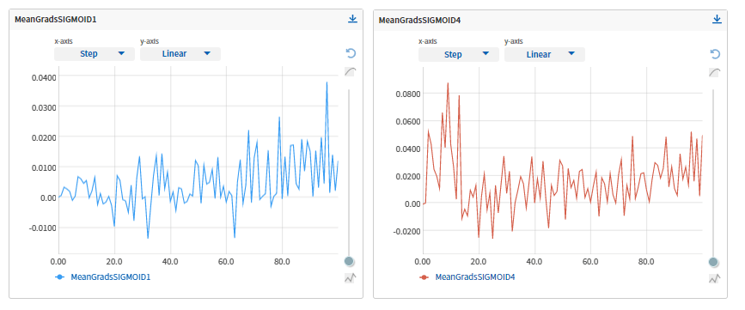
Gradient Plots
Vanishing gradients
Exploding gradients
https://i0.wp.com/neptune.ai/wp-content/uploads/2023/11/how-to-visualize-deep-learning-models-12.png?fit=867%2C361&ssl=1

Slide 51
Visualizing Trained NN
Loss
Activations
Weights
Attribution
Notes:
Activations: We generally think of these as being “what” the network saw. If understanding a neural network is like reverse compiling a computer program, the neurons are the variables, and the activations are the values of those variables.
Weights: We generally think of these as being “how” the neural network computes one layer from the previous one. In the reverse engineering analogy, these are compiled assembly instructions.
Attributions: Attributions try to tell us the extent to which one neuron influenced a later neuron.[2, 3]
We often think of this as “why” the neuron fired. We need to be careful with attributions, because they’re a human-defined object on top of a neural network rather than a fundamental object. They aren’t always well defined, and people mean different things by them. (They are very well defined if you are only operating across adjacent layers!)

Slide 52
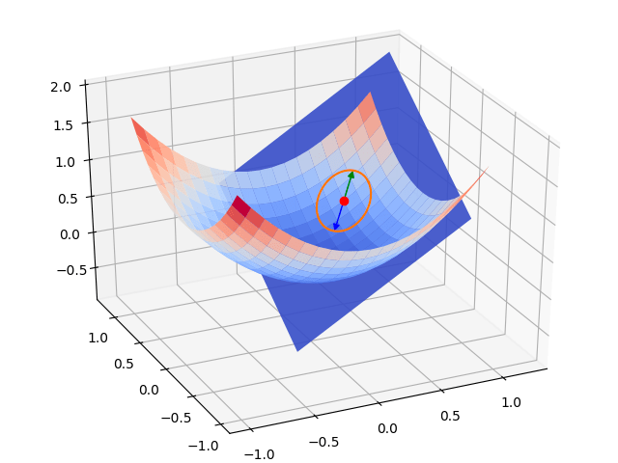
Loss Landscapes
Directly visualizing loss function along with its gradients
https://arxiv.org/pdf/1712.09913

Slide 53
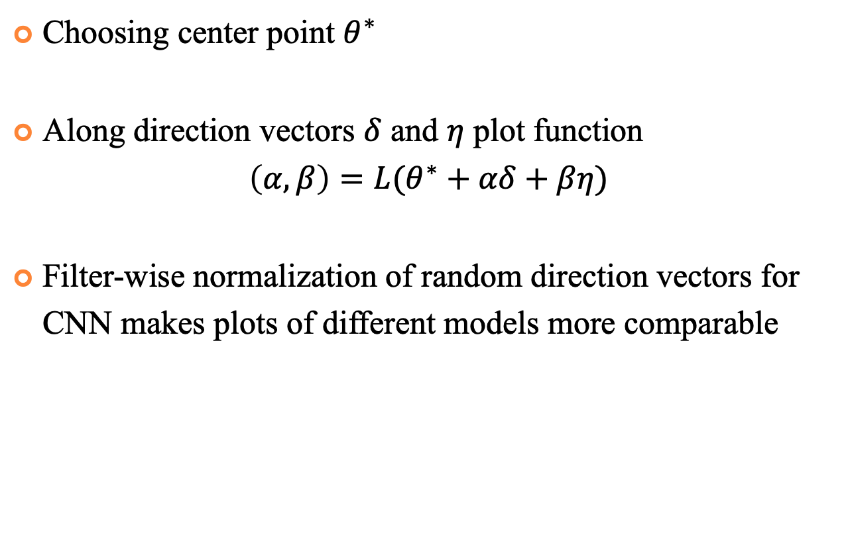
Loss Landscapes
Choosing center point $θ^{∗}$
Along direction vectors $δ$ and $η$ plot function
$$\left(α,β\right)=L(θ^{∗}+αδ+βη)$$
Filter-wise normalization of random direction vectors for CNN makes plots of different models more comparable

Slide 54
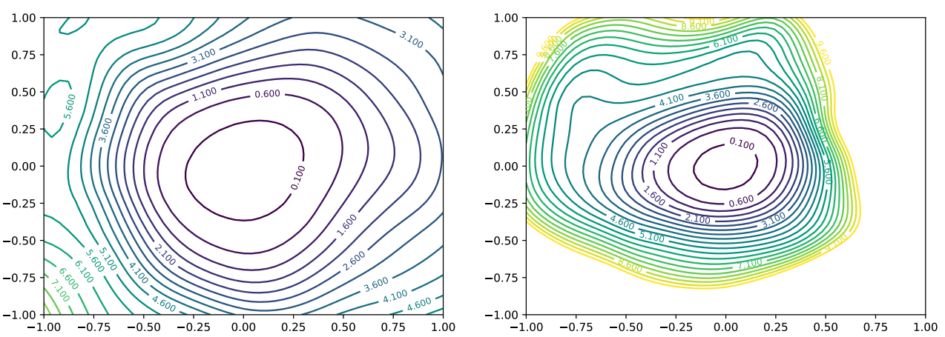
Loss Landscapes
Loss landscape for different sets of parameters
https://arxiv.org/pdf/1712.09913

Slide 55
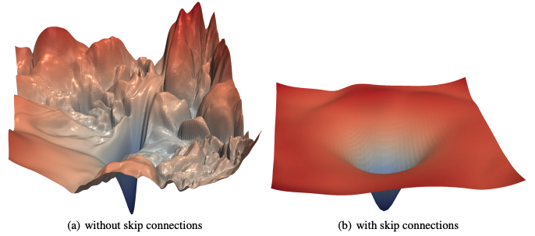
Loss Landscapes
Loss surface of ResNet-56 with and without skip connections
https://arxiv.org/pdf/1712.09913

